Slide 1
Virtual Reality + Leap Motion for Enhanced Air Traffic Control (ATC)
Andrew Moran
6.835: Final Presentation
12 May 2015
Notes:
1
1
Title slide

Slide 2
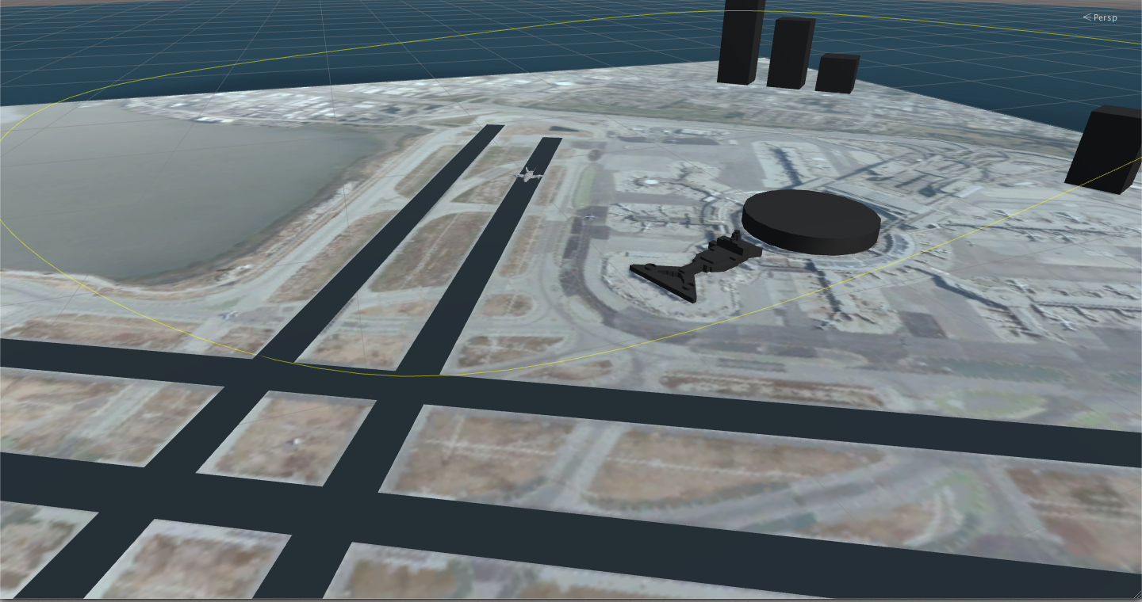
Introduction
Create an Immersive and Interactive Simulation for ATC controllers to coordinate planes

Slide 3
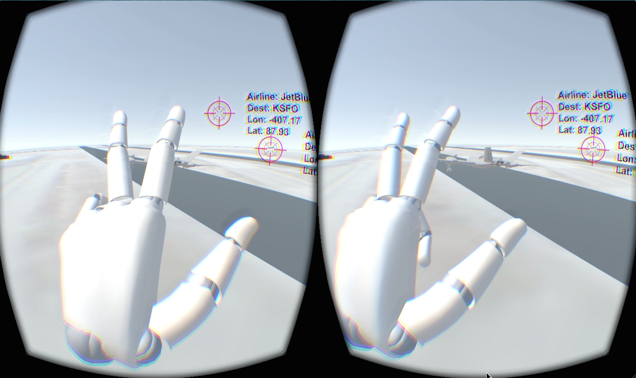
Sample Walkthrough (Just a Taste ☺)
“Use Gestures to Communicate to the planes”

Slide 4
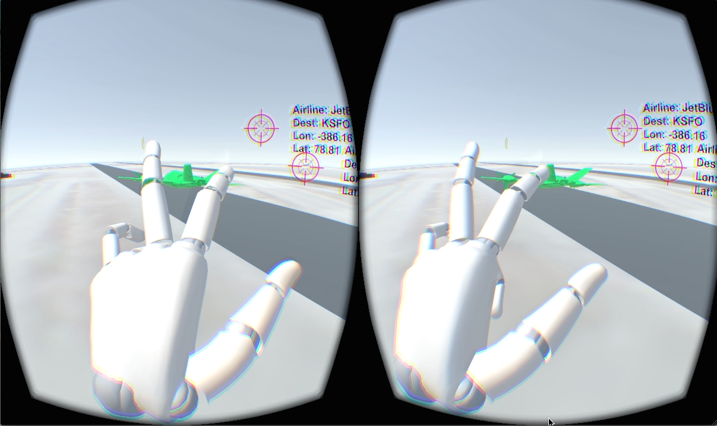
Sample Walkthrough (Just a Taste ☺)
“Use Gestures to Communicate to the planes”

Slide 5
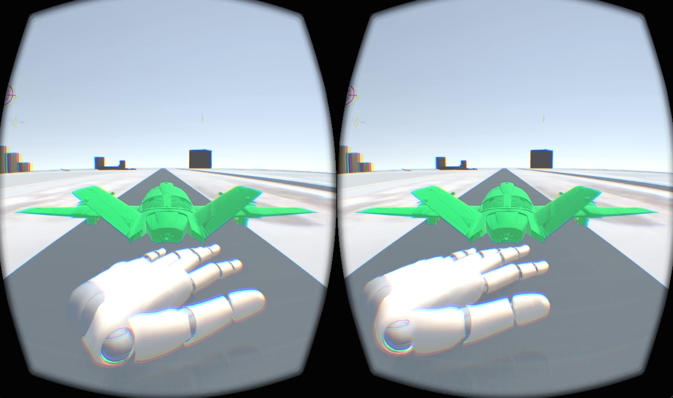
Sample Walkthrough (Just a Taste ☺)
“Use Gestures to Communicate to the planes”

Slide 6
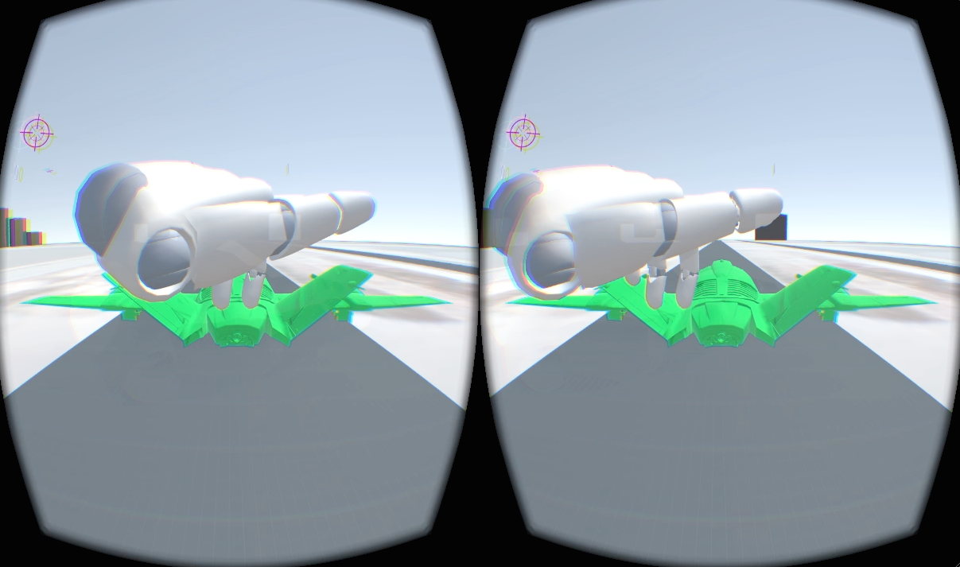
Sample Walkthrough (Just a Taste ☺)
“Use Gestures to Communicate to the planes”

Slide 7
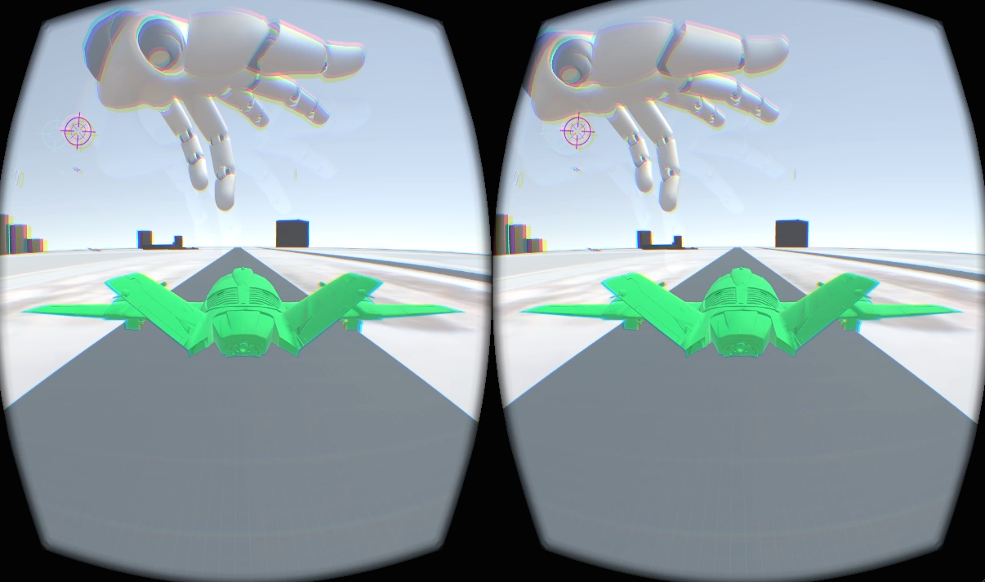
Sample Walkthrough (Just a Taste ☺)
“Use Gestures to Communicate to the planes”

Slide 8
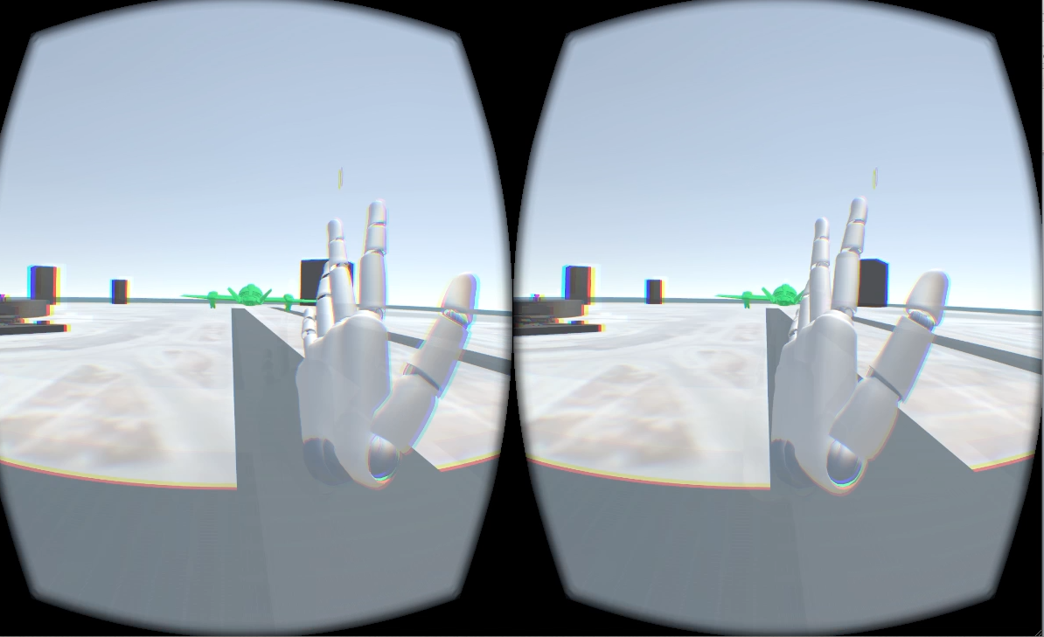
Sample Walkthrough (Just a Taste ☺)
“Use Gestures to Communicate to the planes”

Slide 9
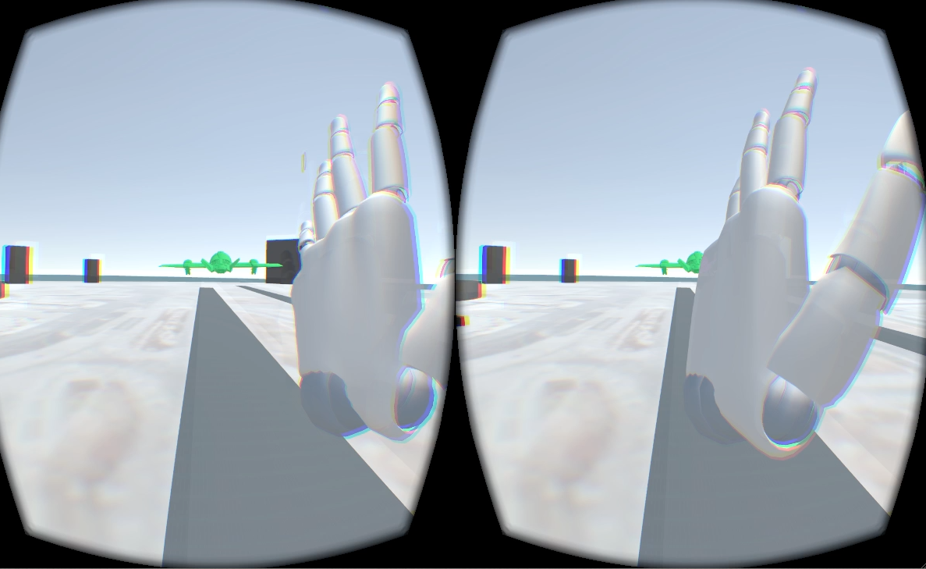
Sample Walkthrough (Just a Taste ☺)
“Use Gestures to Communicate to the planes”

Slide 10
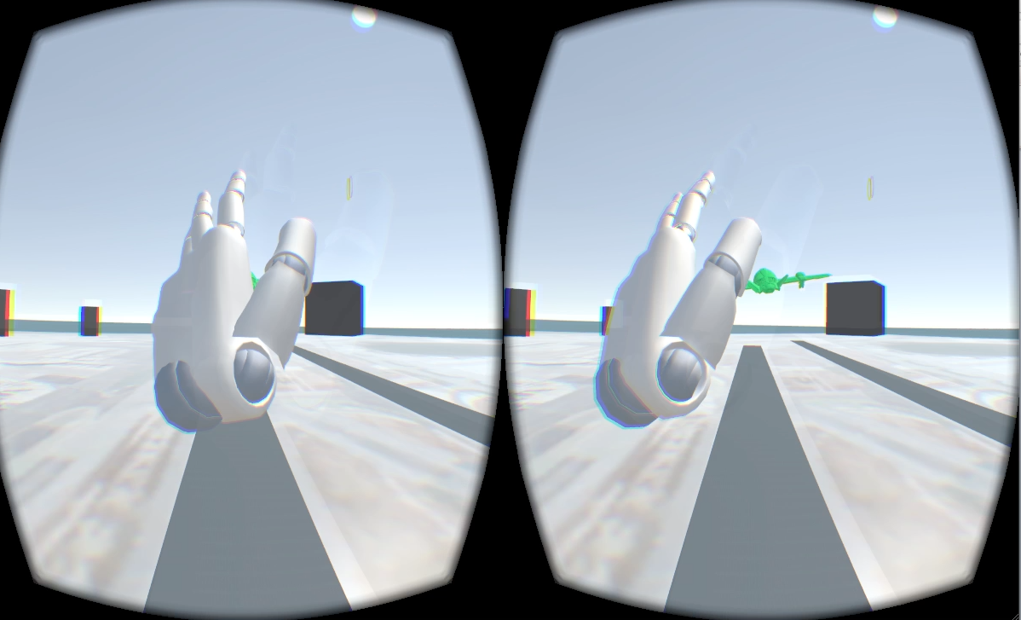
Sample Walkthrough (Just a Taste ☺)
“Use Gestures to Communicate to the planes”

Slide 11
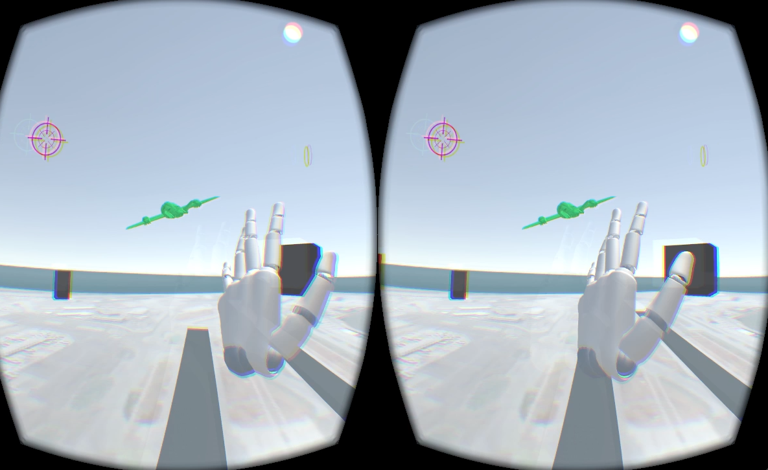
Sample Walkthrough (Just a Taste ☺)
“Use Gestures to Communicate to the planes”

Slide 12
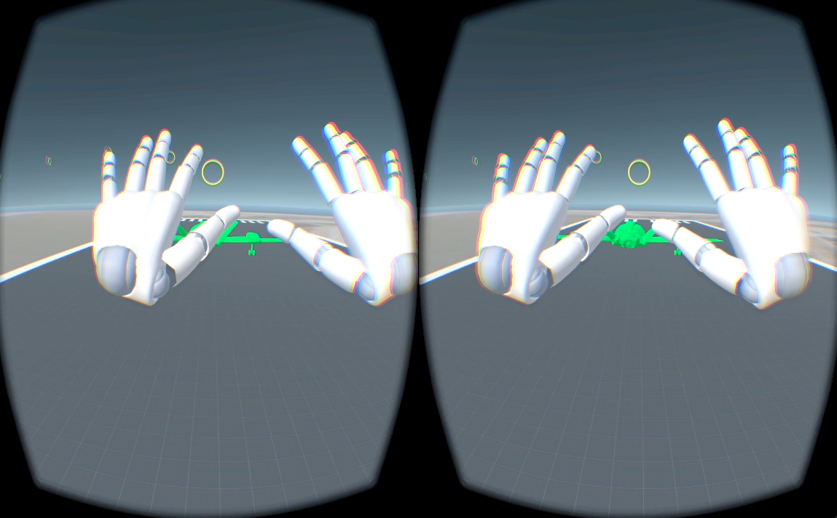
Sample Walkthrough (Just a Taste ☺)
“Use Gestures to Communicate to the planes”

Slide 13
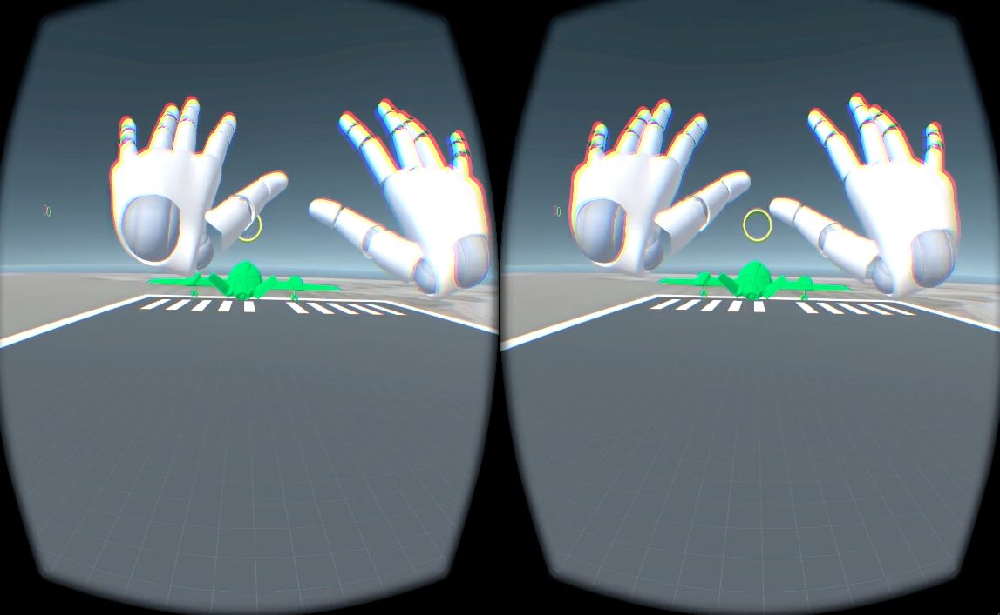
Sample Walkthrough (Just a Taste ☺)
“Use Gestures to Communicate to the planes”

Slide 14
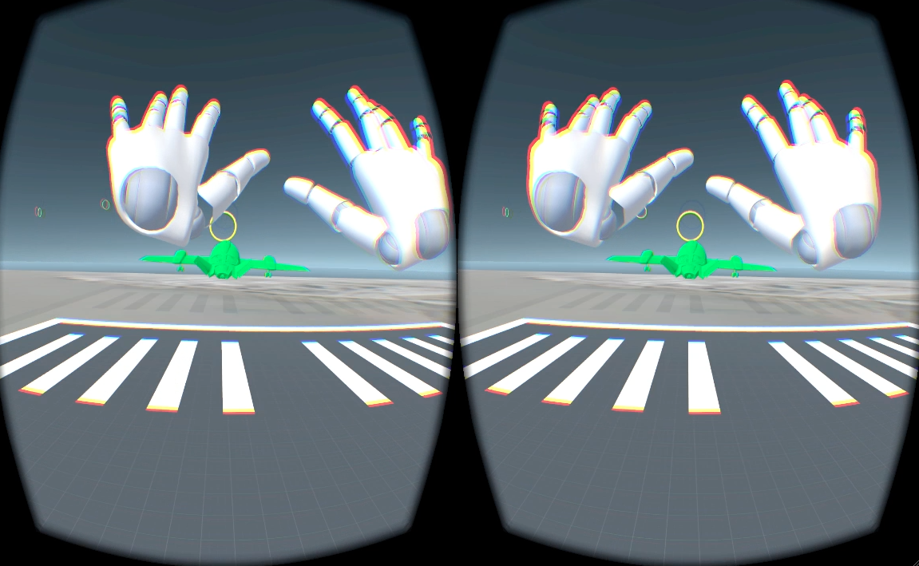
Sample Walkthrough (Just a Taste ☺)
“Use Gestures to Communicate to the planes”

Slide 15
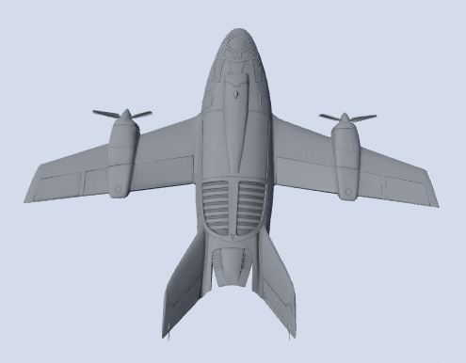



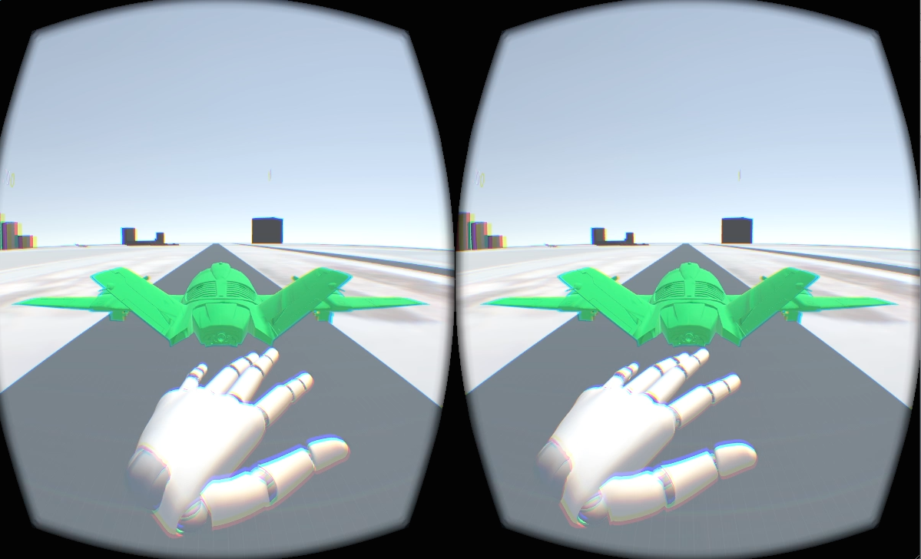
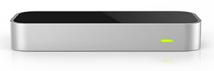
Architecture Overview
1
Define Game Constraints
User Input
Gestures/Input Manager
Unity Integration
Responsive UI
Game
Mechanics
4
3
Input
Manager
Game Engine
Gesture
Recognition
Oculus Rift SDK
2
5
Leap Motion SDK

Slide 16
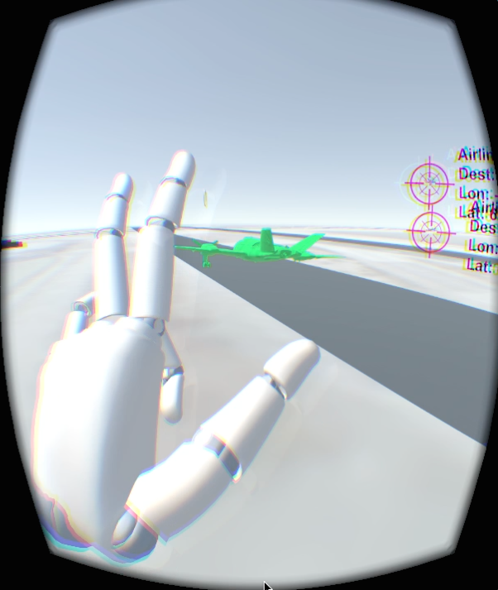
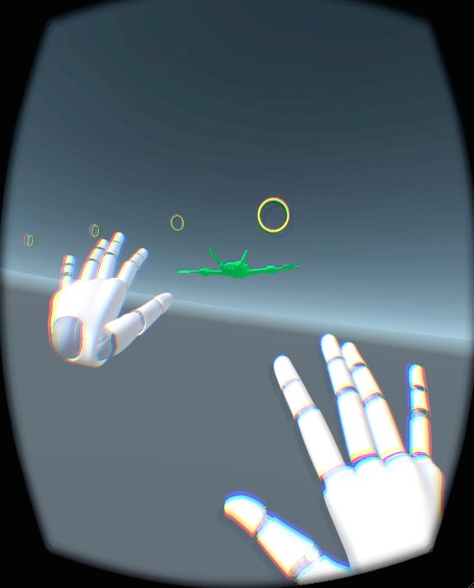
Evaluation
Field Training
Gestures
Takeoff, Roundabout, Land
Camera Switch
Remote Tower, Plane in Focus
OTS Test Scenarios
Manual Piloting
Gestures
Enabled/Disabled
Adjust Navigation
Yaw, Pitch, Roll, Thrust
Timed Obstacle Course

Slide 17
Performance: Gestures
MP
Status
Default Configurations
Leap SDK
Limitations
Raycast from finger direction
Multiple gestures recognized

Slide 18
Performance: Gestures
MP
Status
Raycast from finger location
Direction
Speed
Limitations
Transitioning btw gestures
Relative location of gestures

Slide 19
Performance: Gestures
MP
Status
Stabilization
Separation
Increase collider size
Results
Accuracy > .85

Slide 20
Performance: Usability
FT
Low
>>
Med
>>
High
OTS Test Scenarios
Simple Tasks (Select/Takeoff)
Attentiveness
Plane Coordination
Multiple tasks
Performance/Intensions
“I know where everything is”
“Am I doing this fast enough?”
“Let me re-orient myself”
*Study for 4 participants/10 trials ea.

Slide 21
Performance: Gestures
FT
Status
Recognition of both hands
No constraints
Limitations
Hand off screen / confidence
Trouble controlling thrust

Slide 22
Performance: Gestures
FT
Status
Interaction Box
Control thrust with fists
Speed
Limitations
Trouble stabilizing

Slide 23
Performance: Gestures
FT
Status
Stabilization
Relative to origin
Results
Accuracy >.89

Slide 24
Performance: Usability
MP
Low
>>
Med
>>
High
Timed Obstacle Course
Lap Duration
Average Speed
Waypoints Made
Time active
Performance Rate
“Cool, I got the hang of it”
“Needs to be more forgiving”
“Arms got tired”
“Slow and steady”
*Study for 4 participants/10 trials ea.

Slide 25
Final State/Discussion
Created Immersive and Interactive ATC Simulation
Two phase system
Management - Field Training from ATC tower
Direct Control - Manually Piloting a plane
Very simple levels/scenes
Effective Input Manager and Gesture Recognition
Pros
Situational Awareness
Remote Tower Control
Low visibility
Obstructed Views
Cons
Multi-tasking
Stereoscopic view
Visual Overload
Realtime/Latency

Slide 26
Future Work
MIT Lincoln Lab
ATC Simulators
ATC Contacts
Multi-dimensional scenarios
Plane API
Plane finder, flight aware
Add Speech
More Features/Gestures

